Slide 1

Freedom of Expression & Intellectual Property
Marc J. Randazza

Slide 2
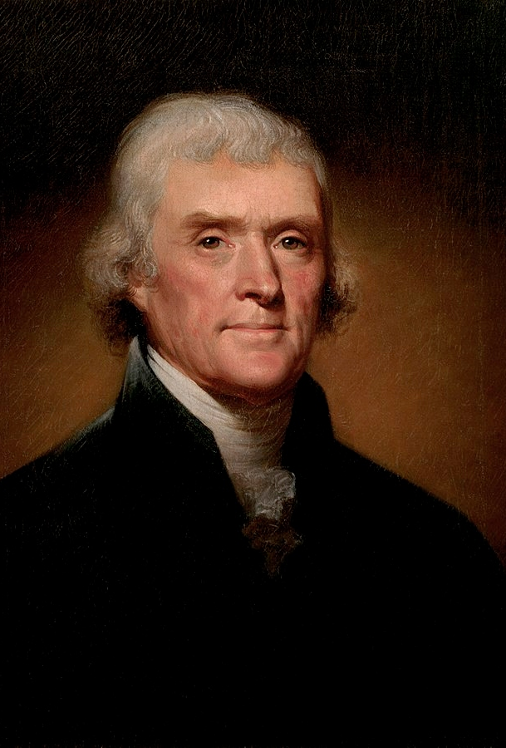

Theories of Free Expression
John Milton – “In a free and open encounter, truth will prevail.”
Thomas Jefferson – “There is no harm in error of opinion ... where reason is left free to combat it”
Relate to IPRs

Slide 3
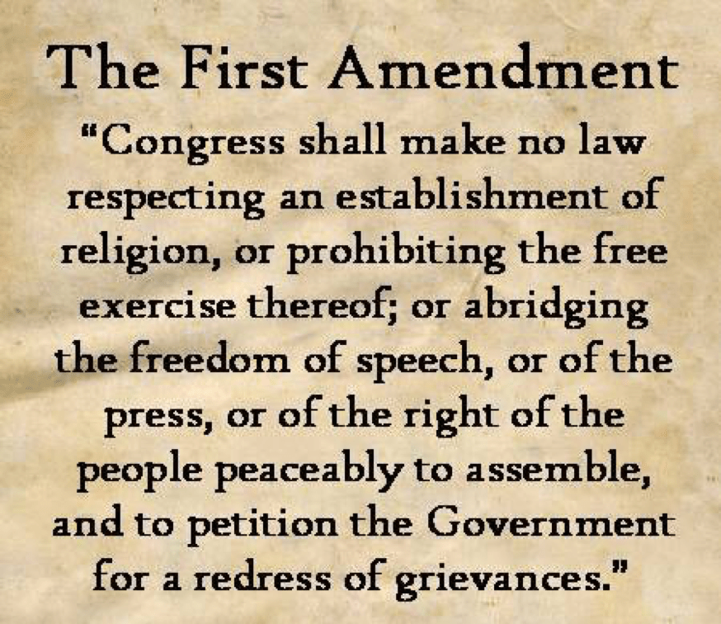
Religion
Speech
Press
Assembly
Petition

Slide 4
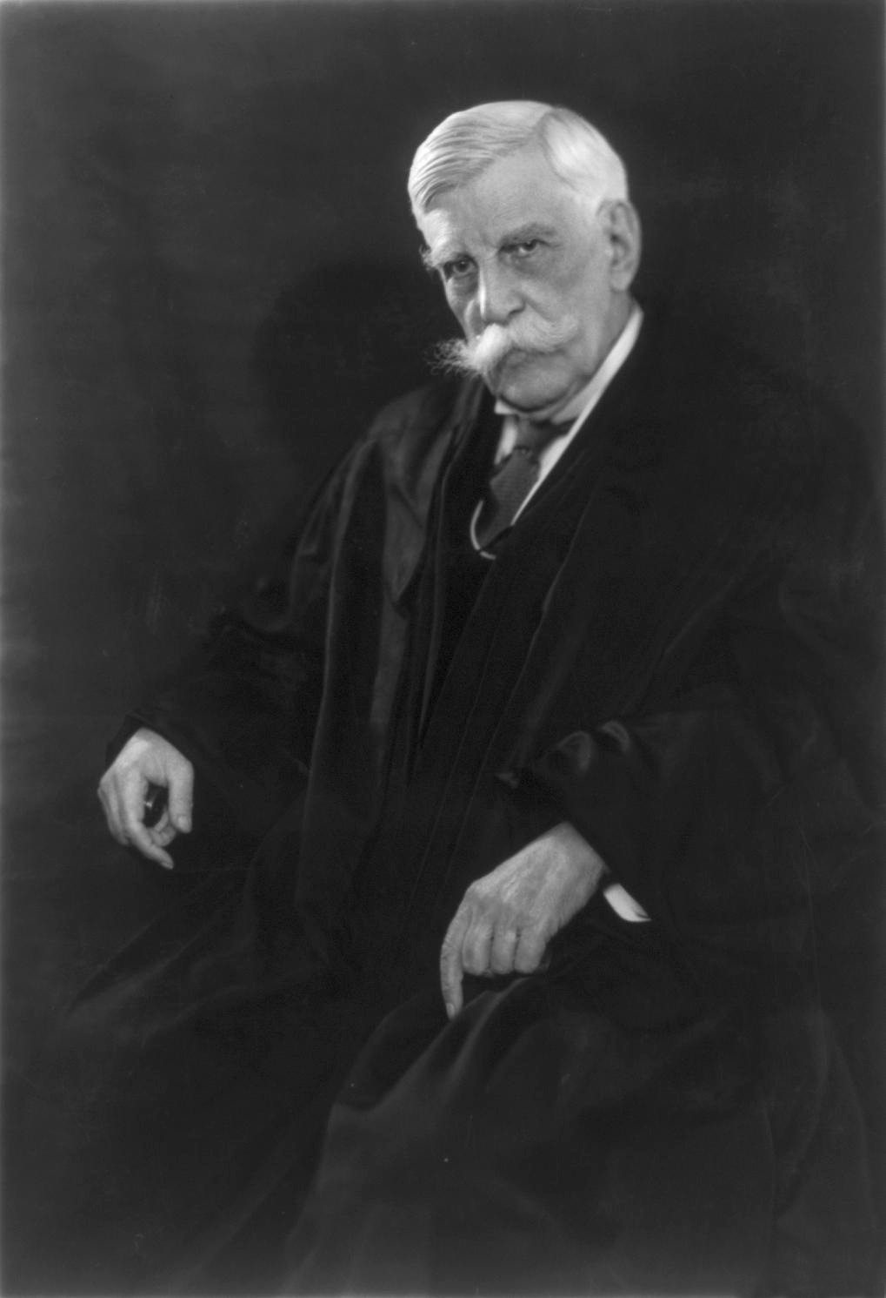
THE MARKETPLACE OF IDEAS
Oliver Wendell Holmes and
The Great Dissent
“when men have realized that time has upset many fighting faiths, they may come to believe even more than they believe the very foundations of their own conduct that the ultimate good desired is better reached by free trade in ideas. . . . The best test of truth is the power of the thought to get itself accepted in the competition of the market, and that truth is the only ground upon which their wishes safely can be carried out”

Slide 5
Origins of Trademarks
Prehistoric Roots (~15,000 years ago)
Lascaux cave paintings (France) show bulls marked with symbols believed to indicate personal or tribal ownership of livestock
Mesopotamia (circa 3500 to 3000 BC): Clay seals and symbols used to denote ownership of goods
Ancient Egypt (6000 to 3000 years ago): Quarry marks and stonecutters’ signs on masonry; marked pottery and wine amphorae to identify source and creator
Ancient China & Rome: Potters’ marks on pottery; Roman brick makers stamped bricks with maker’s marks for quality and origin identification

Slide 6

Early IPR &
Free Expression
Licensing of the Press Act 1662 (Stationers' Act)
  Printing presses had to be licensed
  Enforcement – Fire
Statute of Anne – A law for the advancement of learning
  Similar to later copyright, initial term + renewal

Slide 7
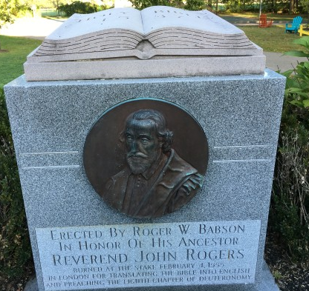
Copyrights and Liberty
United Kingdom’s 1710 Statute of Anne. The first decision interpreting the act was Burnet v. Chetwood
P complained that the D copied his Archaeological Philosophica, which was originally in Latin, and distributed it in English.
The Lord Chancellor agreed with the defense that a translation did not meet the statute’s definition of unlawful copy.
Nevertheless, the Court decided in the plaintiff’s favor.
Book contained “strange notions” that could confuse the lower classes.
“[The Court has] a superintendency over all books, and might in a summary way restrain the printing or publishing any that contained reflections on religion or morality

Slide 8
How Far Does the First Amendment Go?
Nazis in Skokie
God Hates Fags (Westboro Baptist)
Pornography
Journalism
Protest

Slide 9
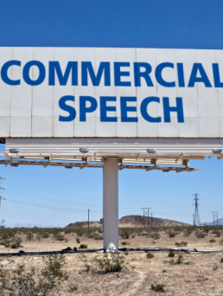
Commercial Speech
Freedom of Expression
Trademarks propose a commercial transaction; i.e. “commercial speech”
Trademarks convey messages about the type, cost and quality of the product or service associated with the mark.
TM is a targeted bit of expressive activity seeking to persuade a consumer to enter into commerce

Slide 10
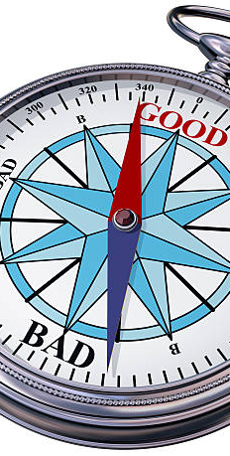
Trademarks and Speech
The Paris Convention and the TRIPS Agreements obligate the member states to protect trademarks
Agreements provide the right for member states to deny registration if the marks themselves are “contrary to morality or public order”
What does that mean?

Slide 11
Commercial Speech
Central Hudson:
  Is the expression protected by the First Amendment?
  Is there a substantial government interest?
  Is the government interest directly advanced by the regulation?
  Is the regulation more extensive than is necessary to serve the state’s interest?
Commercial speech is that expression which is “related solely to the economic interests of the speaker and its audience.” Cent. Hudson Gas & Elec. Corp. v. Pub. Serv. Comm’n of New York, 447 U.S. 557, 561 (1980). ​

Slide 12

Lanham Act and Commercial Speech
Tobinick v. Novella, 884 F.3d 1110 (11th Cir 2015)
Commercial vs. non-commercial impacts the degree of protection provided by the First Amendment.
Bolger v. Youngs Drug Prod. Corp., 463 U.S. 60, 65 (1983).
Dr. Tobinick claimed to be able to treat Alzheimers
Novella challenged these claims
Proxy use for defamation

Slide 13
Moneyberg v. Cornelia
Cornelia published videos incorporating interviews stating Moneyberg's services were of dubious quality
Moneyberg sued Cornelia for defamation and unfair competition – Cornelia filed a special MTD under Nevada's Anti-SLAPP statute
Cornelia prevailed at SJ finding that Cornelia could not have made the statements with actual malice
  Inconstantly the court also found under the Anti-SLAPP analysis that the statement was not made in good faith
Moneyberg appealed to the 9th Circuit and Cornelia cross-appealed hoping to get the inconsistent decision on the Anti-SLAPP reversed
  The 9th Circuit affirmed the SJ decision and overturned the lower court's decision on the Anti-SLAPP issue

Slide 14
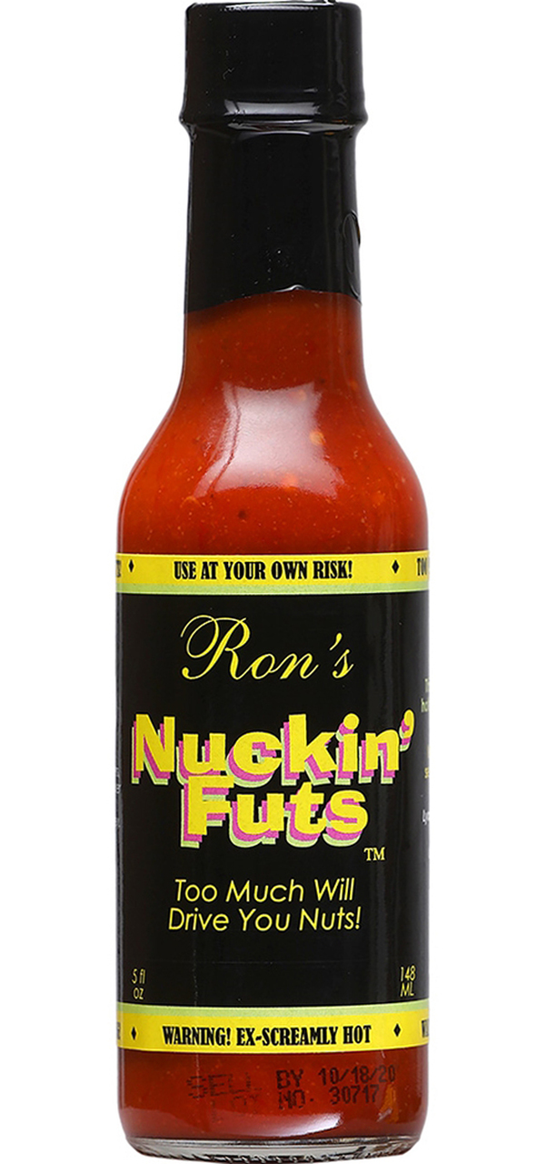
Trademarks and Expression
Australian Trade Marks
Examiner must reject a trademark application if “(a) the trade mark contains or consists of scandalous matter or (b) its use would be contrary to law.”
From the “ordinary” person perspective whether a trade mark is
  shameful,
  offensive, or
  shocking, and therefore be rejected.
In a 2012 decision, a mark owner prevailed in its argument that Section 42 does not prohibit the mark “Nuckin Futs.”
“fuck” and “fucking” were “now part of the universal discourse of the ordinary Australian”

Slide 15
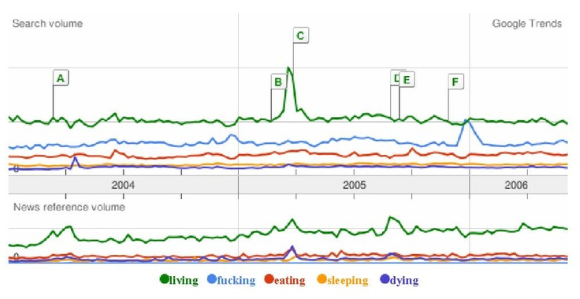

Trademarks and Expression
Fuckingmachines case
...it is clear from the evidence attached that a significant composite of the public still feels a jolt of offense, shock, or dismay when they overhear the word uttered in public.
SUBSTANTIAL COMPOSITE

Slide 16
Trademarks and Morality
Consistent with International Agreements to ban immoral marks?
  Article 6 quinquies of the Paris Convention allows it
  But see Art. 10 bis. - Member states are bound to assure their nationals of protection from unfair competition

Slide 17

Trademarks and Expression
(under the Agreements)
Article 10 of the European Convention on Human Rights (“ECHR”) protects freedom of expression.
Any derogation of that right requires justification under Article 10(2)
Anheuser-Busch v. Portugal
  Legitimate expectation of a property interest in an IPR

Slide 18
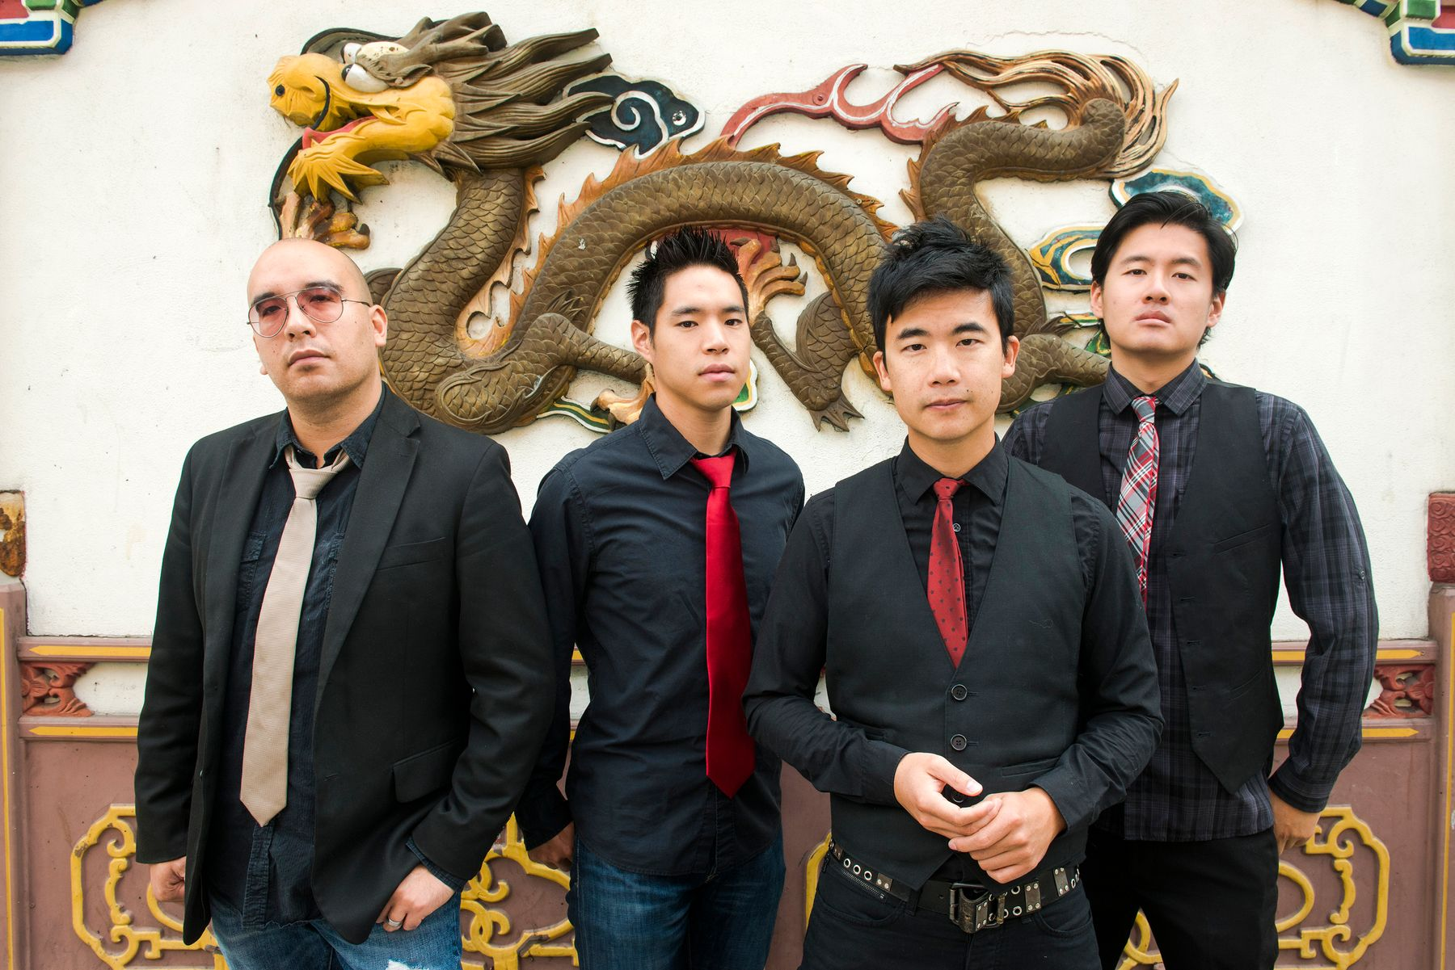
Trademarks and
Free Expression
Back to the USA
Dykes on Bikes
Buddha Beachwear
Matal v. Tam - Sea change, 8-0 decision, First Amendment applies to TM registrations
Rash of new marks, little downside.
USPTO Claiming previously “offensive” marks as “descriptive” (COCK CONTROL and ANAL4K)

Slide 19
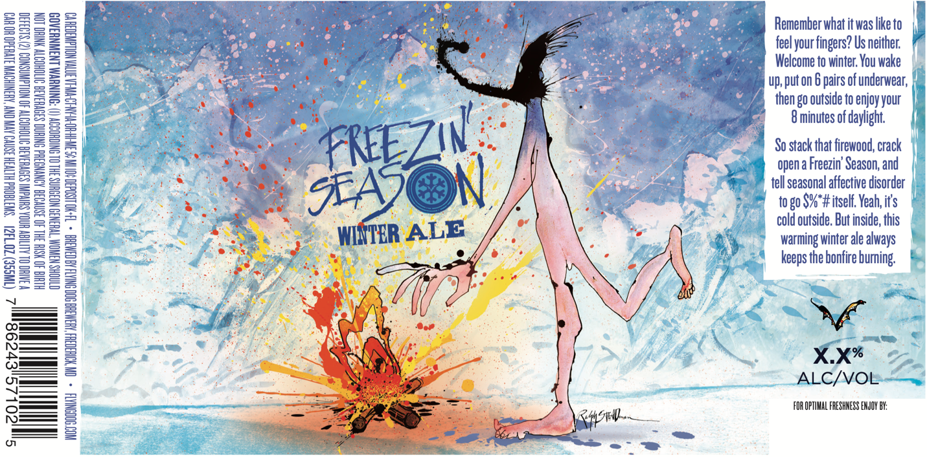
Commercial Speech Freedom of Expression
Flying Dog Brewery
Commercial Speech
Prohibition on beer labels that are “undignified, immodest, or in bad taste”

Slide 20
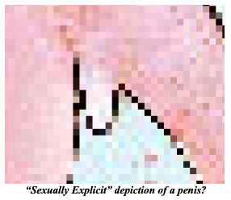
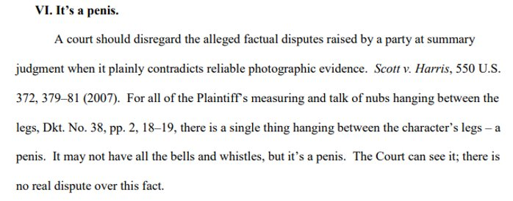
Commercial Speech and Free Speech
Commercial vs. non-commercial impacts the degree of protection provided by the First Amendment.
Bolger v. Youngs Drug Prod. Corp., 463 U.S. 60, 65 (1983).
Commercial speech is that expression which is “related solely to the economic interests of the speaker and its audience.” Cent. Hudson Gas & Elec. Corp. v. Pub. Serv. Comm’n of New York, 447 U.S. 557, 561 (1980).

Slide 21
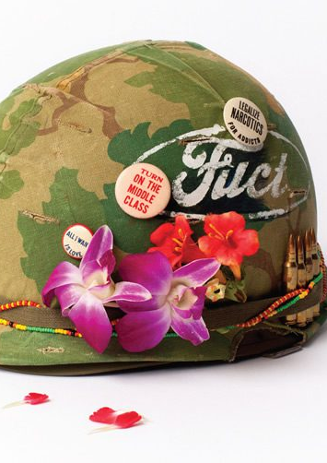
Commercial Speech and
Free Expression
Matal v. Tam, 137 S. Ct. 1744 (2017)
  “Speech may not be banned on the ground that it expresses ideas that offend.”
  When the government's substantial interest is framed as “preventing speech expressing ideas that offend,” such an idea “strikes at the heart of the First Amendment.”
Iancu v. Brunetti, 139 S. Ct. 2294 (2019)
  Finding “immoral or scandalous” bar unconstitutional, noting that these terms were interpreted to mean “shocking,” “offensive,” and “disreputable,” and thus constituted viewpoint-based discrimination
Flying Dog:
  Regulation is facially unconstitutional because it is overbroad and otherwise not narrowly tailored to achieve North Carolina's proffered substantial interest.

Slide 22

Copyrights and Free Expression
Enforceability – Can it be limited by the government on the basis of content?
Private Enforcement – what speech values come into play?

Slide 23
Copyrights and Speech
Articles 27 and 15 of the (“UDHR”) protects the right to the moral and material interests resulting from artistic productions and user’s rights to participate in the cultural life of the community.
Copyright has been observed to be a “human right equal to freedom of expression”

Slide 24
Copyrights and Speech
Three Step Test and other Exceptions
Three Step Test under Berne Convention
  (Article 9(2), added in 1967)
  expanded in later treaties.
Exceptions or limitations to copyright ok IF:
Confined to certain special cases;
Do not conflict with a normal exploitation of the work; and
Do not unreasonably prejudice the legitimate interests of the right holder
TRIPS Agreement (1994), Article 13 “Members shall confine limitations and exceptions to exclusive rights to certain special cases which do not conflict with a normal exploitation of the work and do not unreasonably prejudice the legitimate interests of the right holder."

Slide 25
Copyrights and Expression
In Hyde Park Residents Limited v Yelland, Jacob J. held that “in principle public policy can prevent copyright enforcement completely.” (1999)
Under Section 171(3) of the Copyright Patents and Designs Act 1988, U.K. courts have recognized that they still have the power to deny enforcement on public policy grounds.
“[n]othing in this Part affects any rule of law preventing or restricting the enforcement of copyright, on grounds of public interest or otherwise”

Slide 26
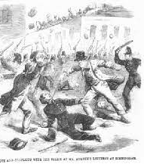
Obscenity
Regina v. Hicklin, L.R. 2 Q.B. 360 (1868)
“whether the tendency of the matter charged as obscenity is to deprave and corrupt those whose minds are open to such immoral influences and into whose hands a publication of this sort may fall."
Focused on the effect the allegedly obscene article had on the most corruptible readers and not on the book’s actual contents.

Slide 27
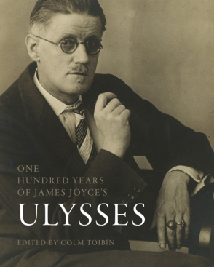
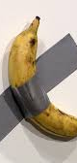
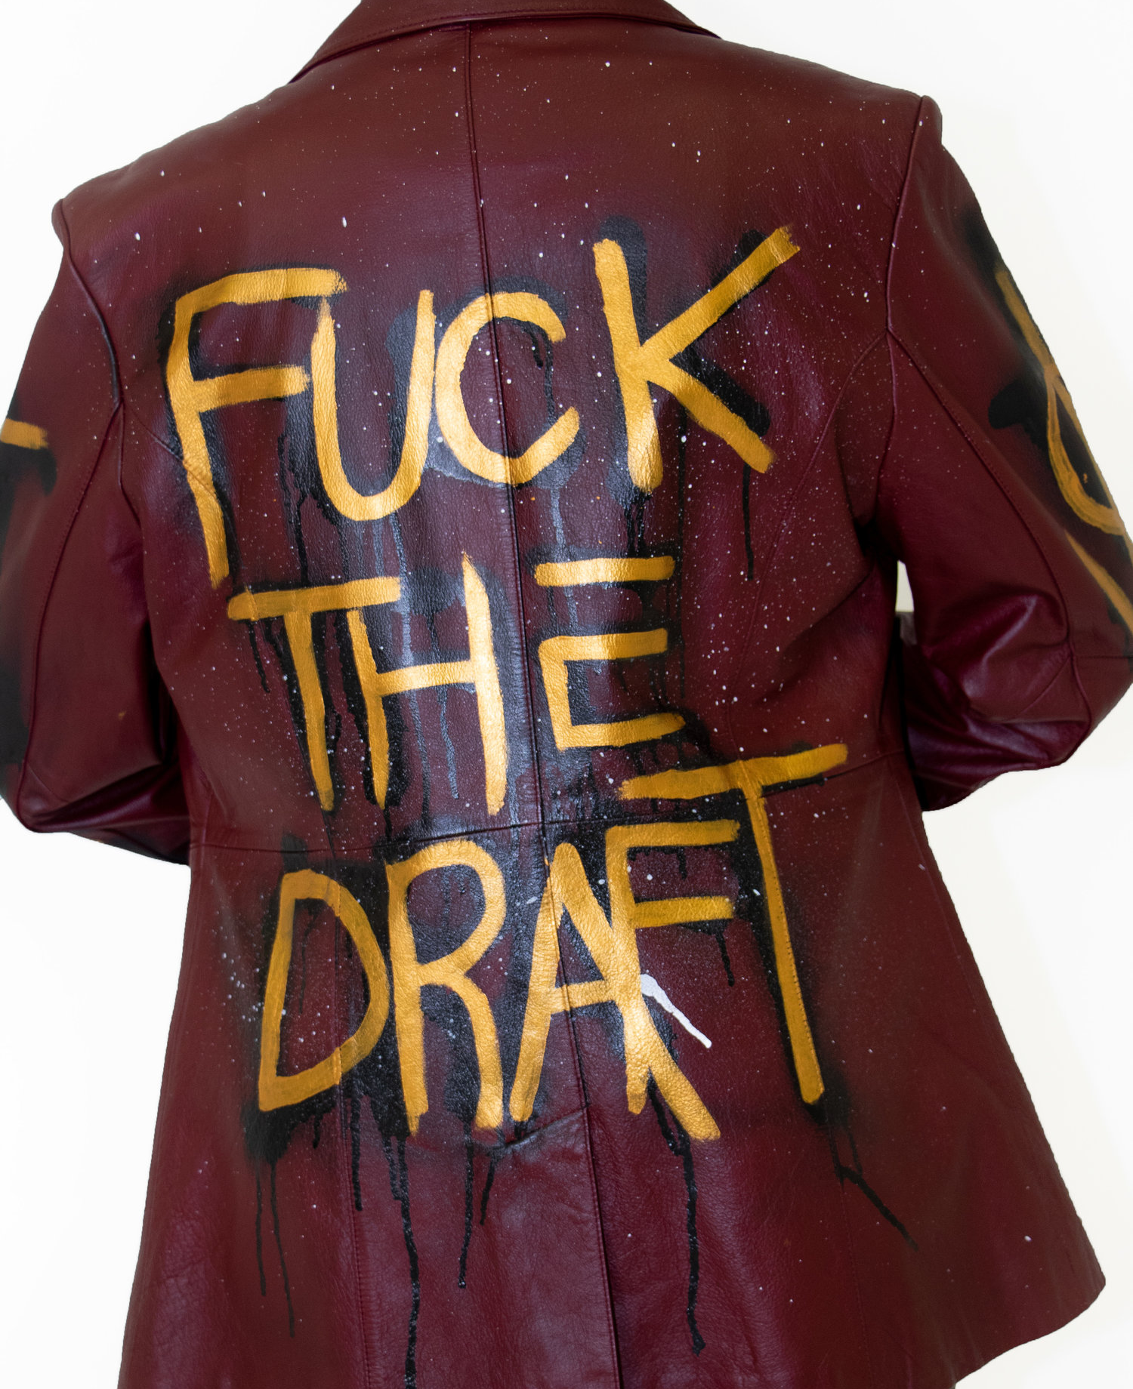
Ulysses
I think this is the most damnable slush and filth that ever polluted paper in print. . . . There are no words I know to describe, even vaguely, how disgusted I am; not with the mire of his effusion but with all those whose minds are so putrid that they dare allow such muck and sewage of the human mind to besmirch the world by repeating it—and in print, through which medium it may reach young minds. Oh my God, the horror of it.
—Margaret Anderson
One Man's Vulgarity
is another man's Lyric
-Cohen v. California

Slide 28
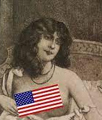
Miller v. California, 413 U.S. 15 (1973)
Current State of Obscenity Law
The Miller Test.
  1) Does the work appeal to prurient interest?
  2) Does the work depict or describe sexual conduct in an offensive manner under applicable state law?
  3) As a whole, does the work lack serious literary, artistic, political, or scientific value?
  If you fail, you can go to jail!

Slide 29
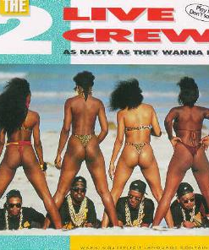
Campbell v. Acuff-Rose Music
510 U.S. 569 (1994)
2 Live Crew parody of Roy Orbison’s “Pretty Woman.”
Highly sexualized take on romantic song.
Court found that parodies even in bad taste were protected under doctrine of fair use.

Slide 30
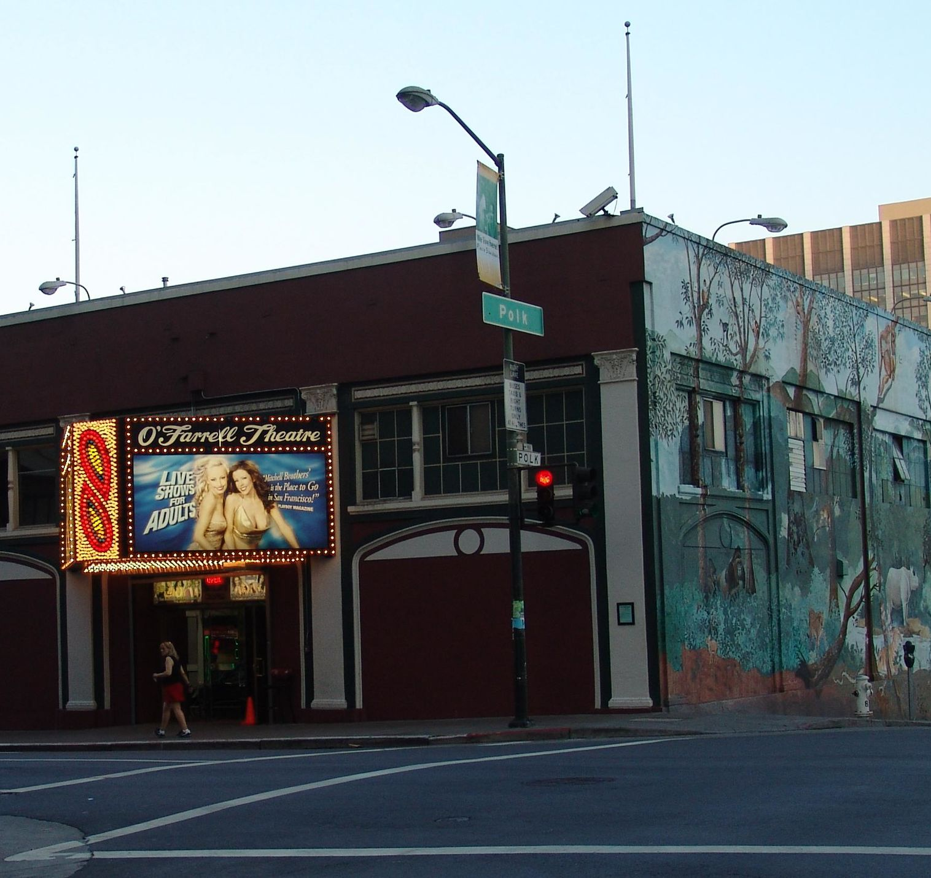
Copyrights and Morality Impediments to Enforcement
Mitchell Brothers – obscenity was copyrightable.
Scholars argued that perhaps this should not be the case.
Liberty Media Footnote 1.

Slide 31

Copyrights and Speech Limitations
Taiwan Court held that pornographic works were not subject to copyright protection under Art. 3 of the Taiwanese Copyright Act.
In Case 250 of 1999, the Taiwanese Supreme Court held that since pornography is against social order and the public interest, it is not subject to copyright protection.
Feb. 2014, Taiwan Sup. Ct. held otherwise – that foreign works were subject to protection under Berne, but not domestic.

Slide 32
Copyrights and Speech Values
USA denied protection for more than a century to “immoral” works.
Songs containing slang
Pornography
Immorality
"Son of Sam" Laws

Slide 33

Copyrights and Speech
(moral issues)
Venus Adult Shops Pty Ltd v. Fraserside Holdings Ltd,188 the Federal
content-based restrictions are intolerable
Down Under. The court noted that there is no “public interest defense” to copyright infringement

Slide 34
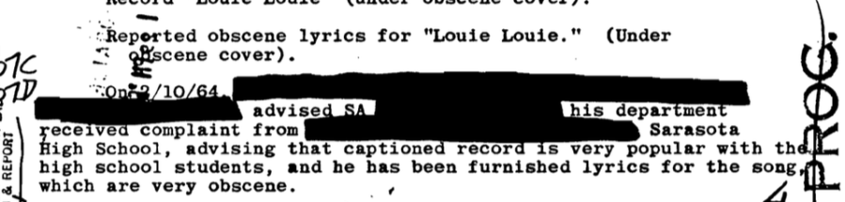
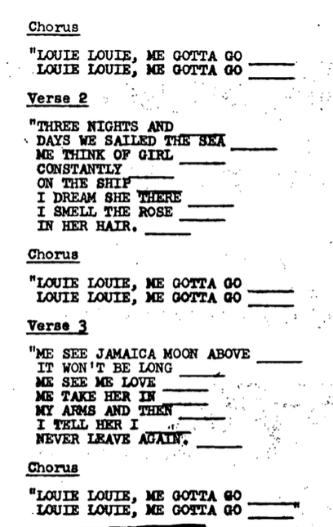
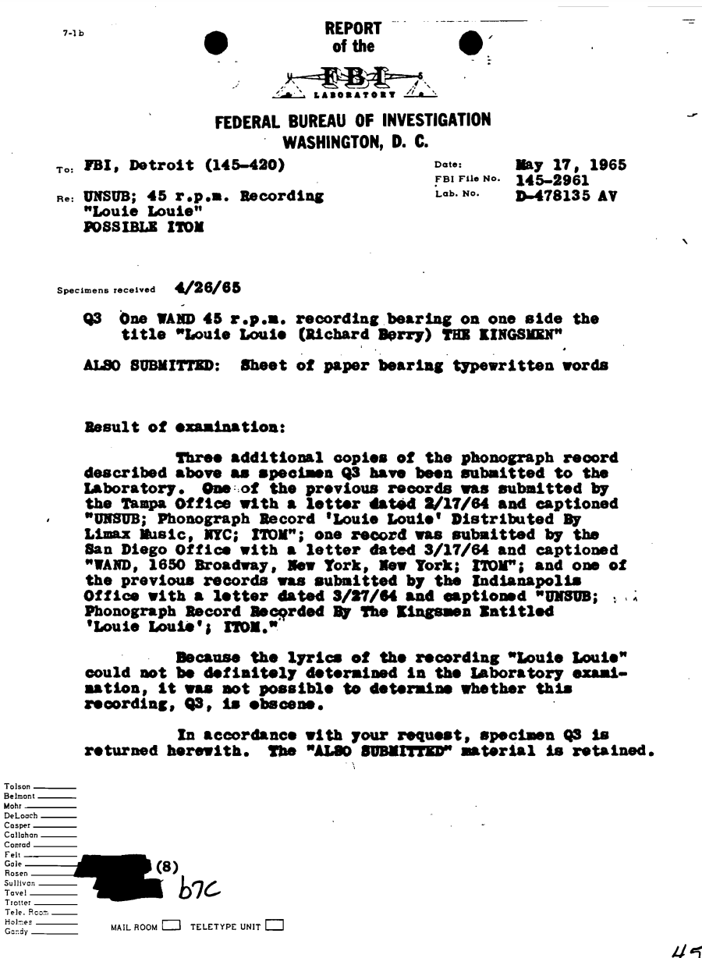
Louie Louie
From Copyright Registry

Slide 35
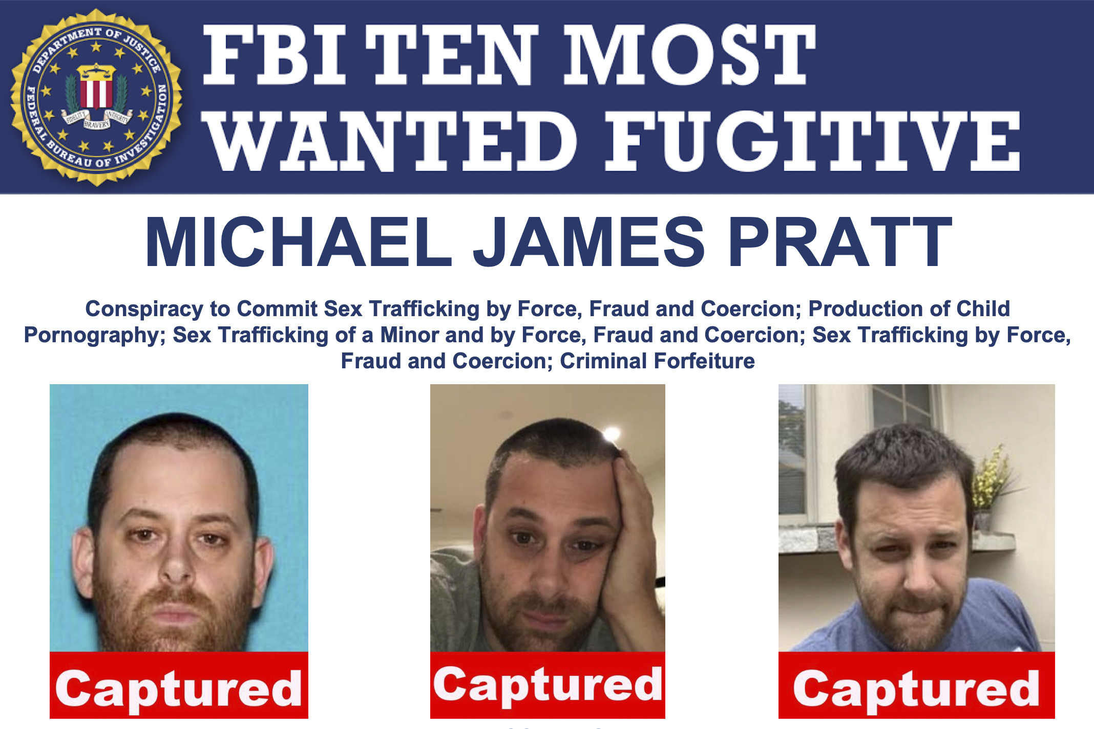
MCM Group 22 LLC v.
Lyndon Perry
Prior case: Porn company sued by performers claiming fraud, misrepresentation, duress
Site operators later prosecuted
In judgment, court awards copyrights to works to performers
Performers transfer copyrights to corporate entity (MCM) to police use of videos, issue takedown notices under DMCA, and sue for infringement

Slide 36
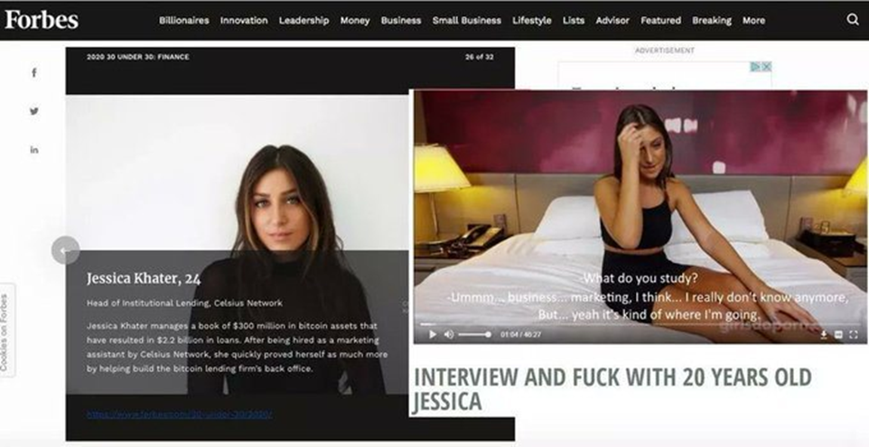
MCM Group 22 LLC v. Lyndon Perry
Using copyright as a weapon against free speech
Celsius Network files for bankruptcy
In thread, Perry posts image juxtaposing “Head of Institutional Lending” Forbes profile with screenshot from interview in porn appearance
MCM Group 22 files suit, claiming copyright infringement
Is the collage transformative?
Is it commercial if Perry solicits donations?
Is it a whole image or 1/83,610 of a video?
Does increasing demand for the video harm a market where MCM doesn’t want anyone viewing it?

Slide 37
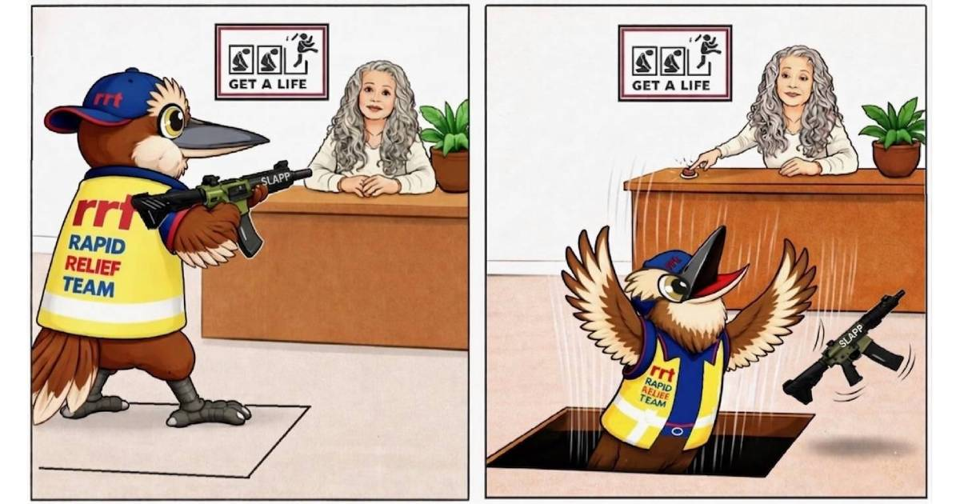
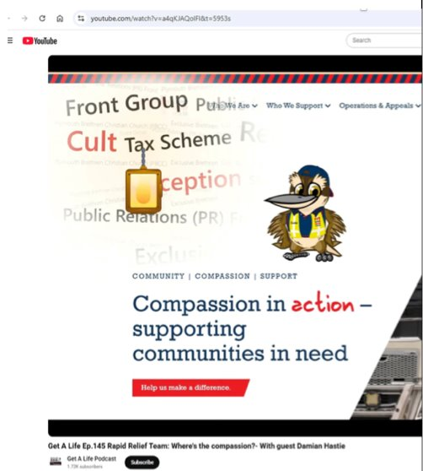
Bawtinheimer Exercise
Bawtinheimer grew up in a cult,
After leaving, she started a podcast with other former members discussing their experiences in the cult
A charitable arm of PBCC is the Rapid Relief Team - Bawtinheimer made a video pointing out the hypocrisy of PBCC's actions towards members and statements RRT makes, in this video she showed the RRT website and its logo
  In response to this video RRT sued Bawtinheimer for copyright infringement
Countersued for abuse of DMCA (used to get YouTube to take the videos down)
How does copyright law interact with the First Amendment?
Was this fair use?
What are the implications if this was deemed copyright infringement?

Slide 38
Conclusion
Amendment I, US Const.
17 USC § 512(f)
Int'l Agreements
Obscenity

